Slide 1

Wellness Event The Winter Brain: Boosting Cognitive Energy “Warm Up Your Brain This Winter”
Presented by
Presenter Name Here
Date Here

Slide 2
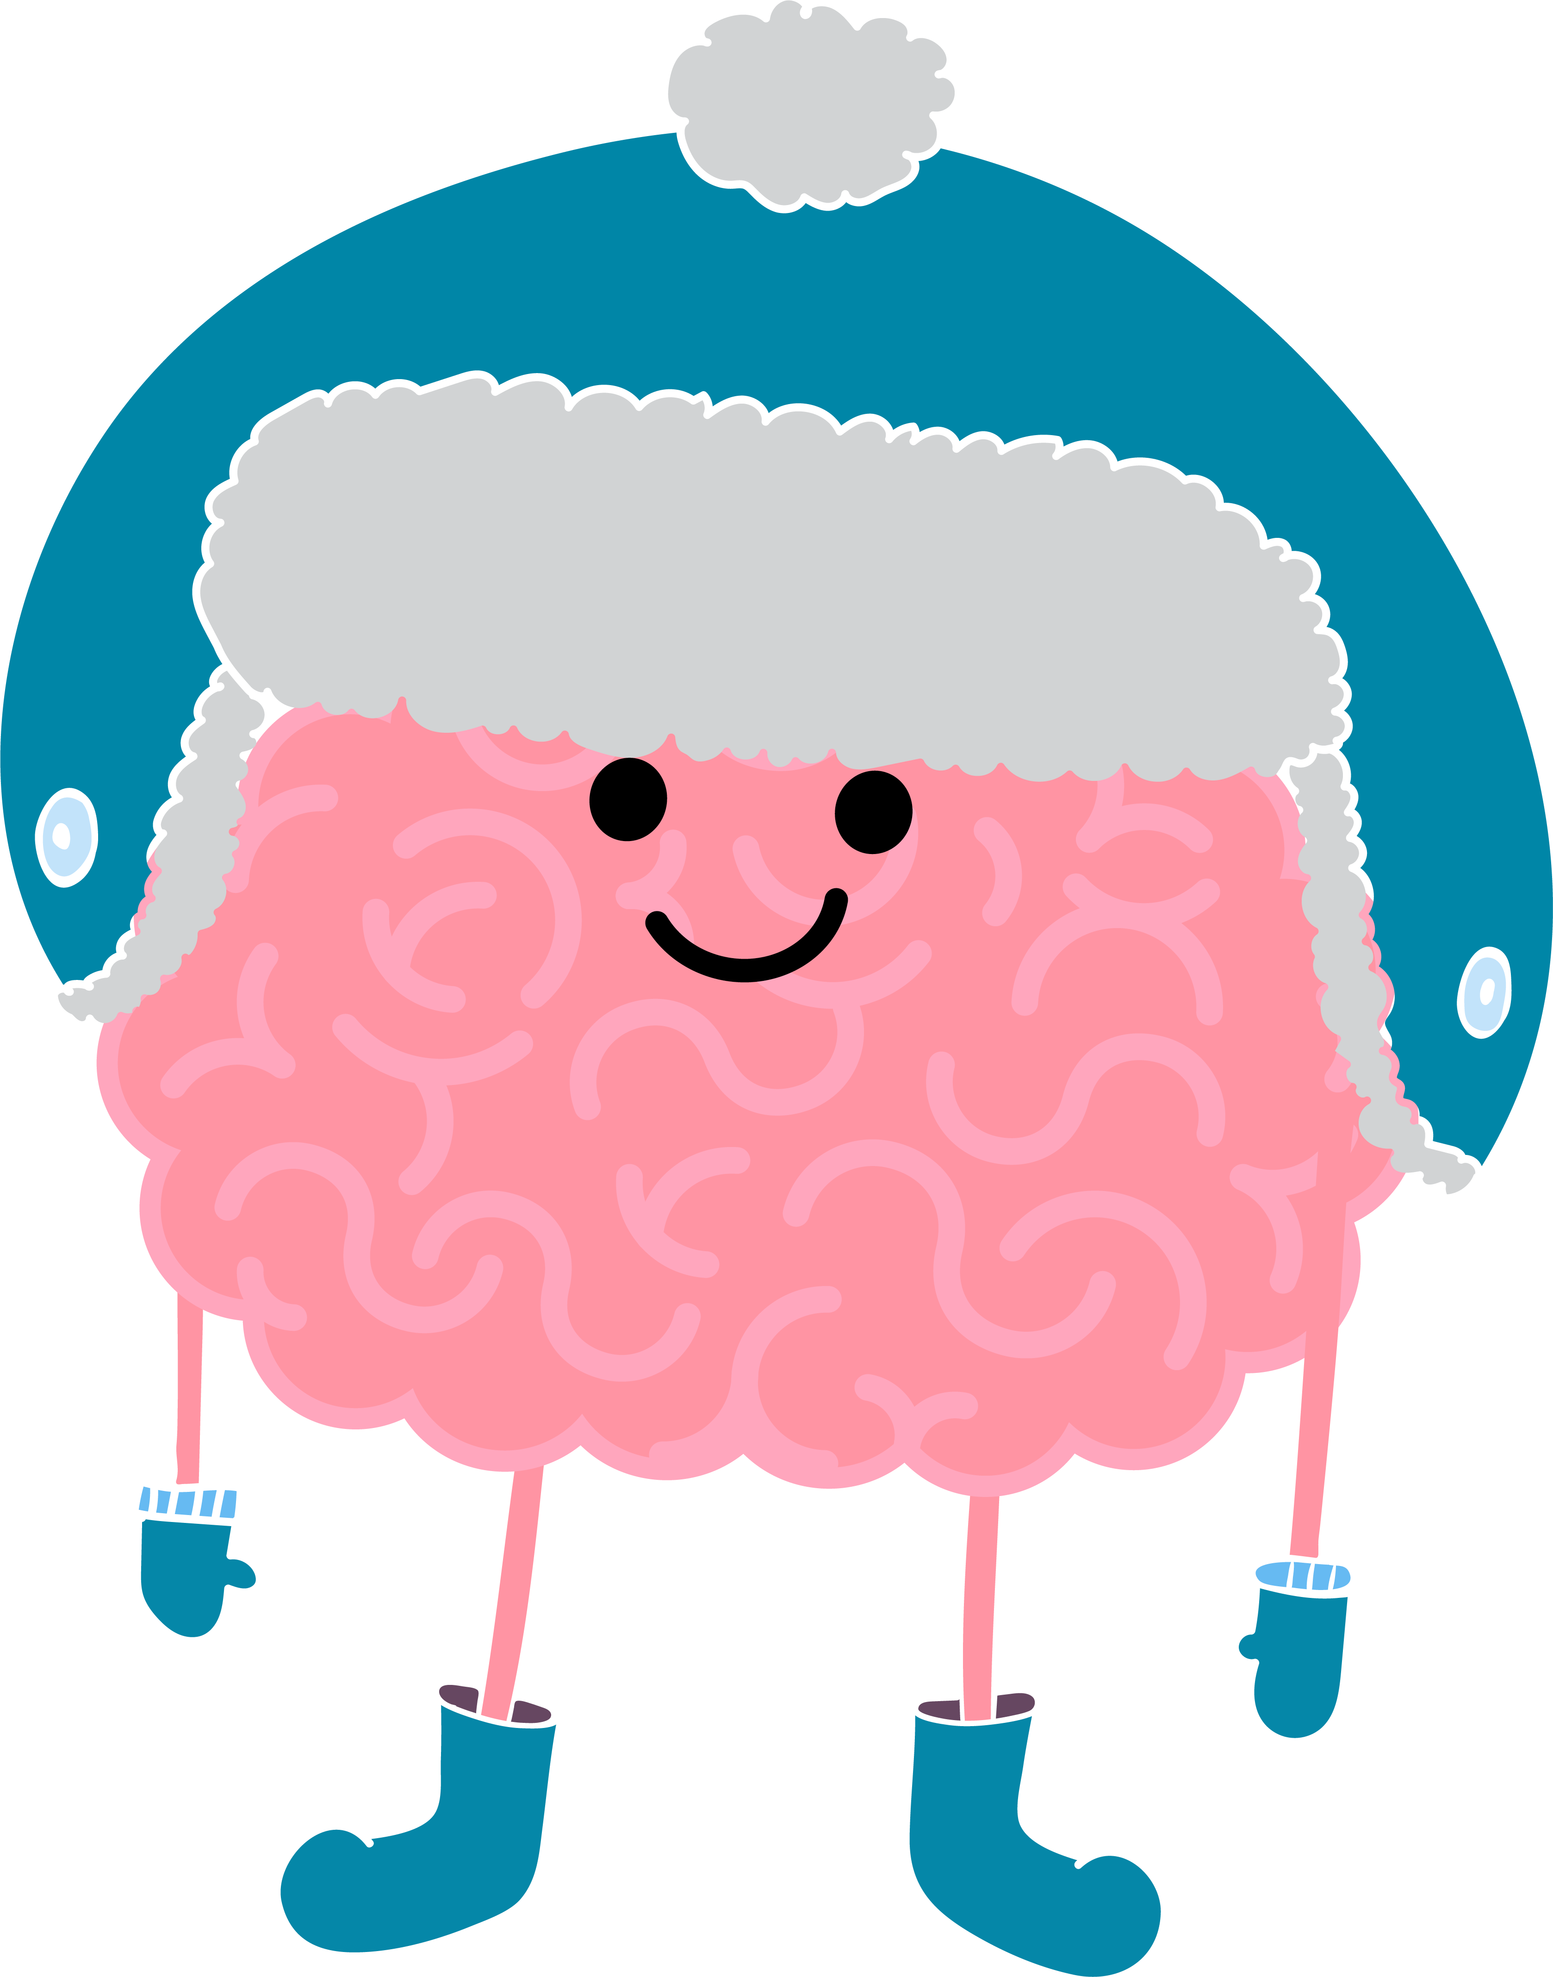
Overview
According to a 2014 study by NIH, brain games and exercises that stimulate the brain help older adults maintain reasoning skills and result in improved cognitive abilities for 10 years.
Puzzles and brain games are fun activities to keep you mentally sharp, active and avoid depression and anxiety.

Slide 3
The Winter Brain: Boosting Cognitive Energy
As the winter months settle in, our bodies and minds crave a little extra care. With less sunlight and more time indoors, it’s easy for energy and clarity to dip.
This month, we’re focusing on simple, meaningful ways to “warm up” the brain — lighting a spark in how we think, move, connect, and engage.

Slide 4
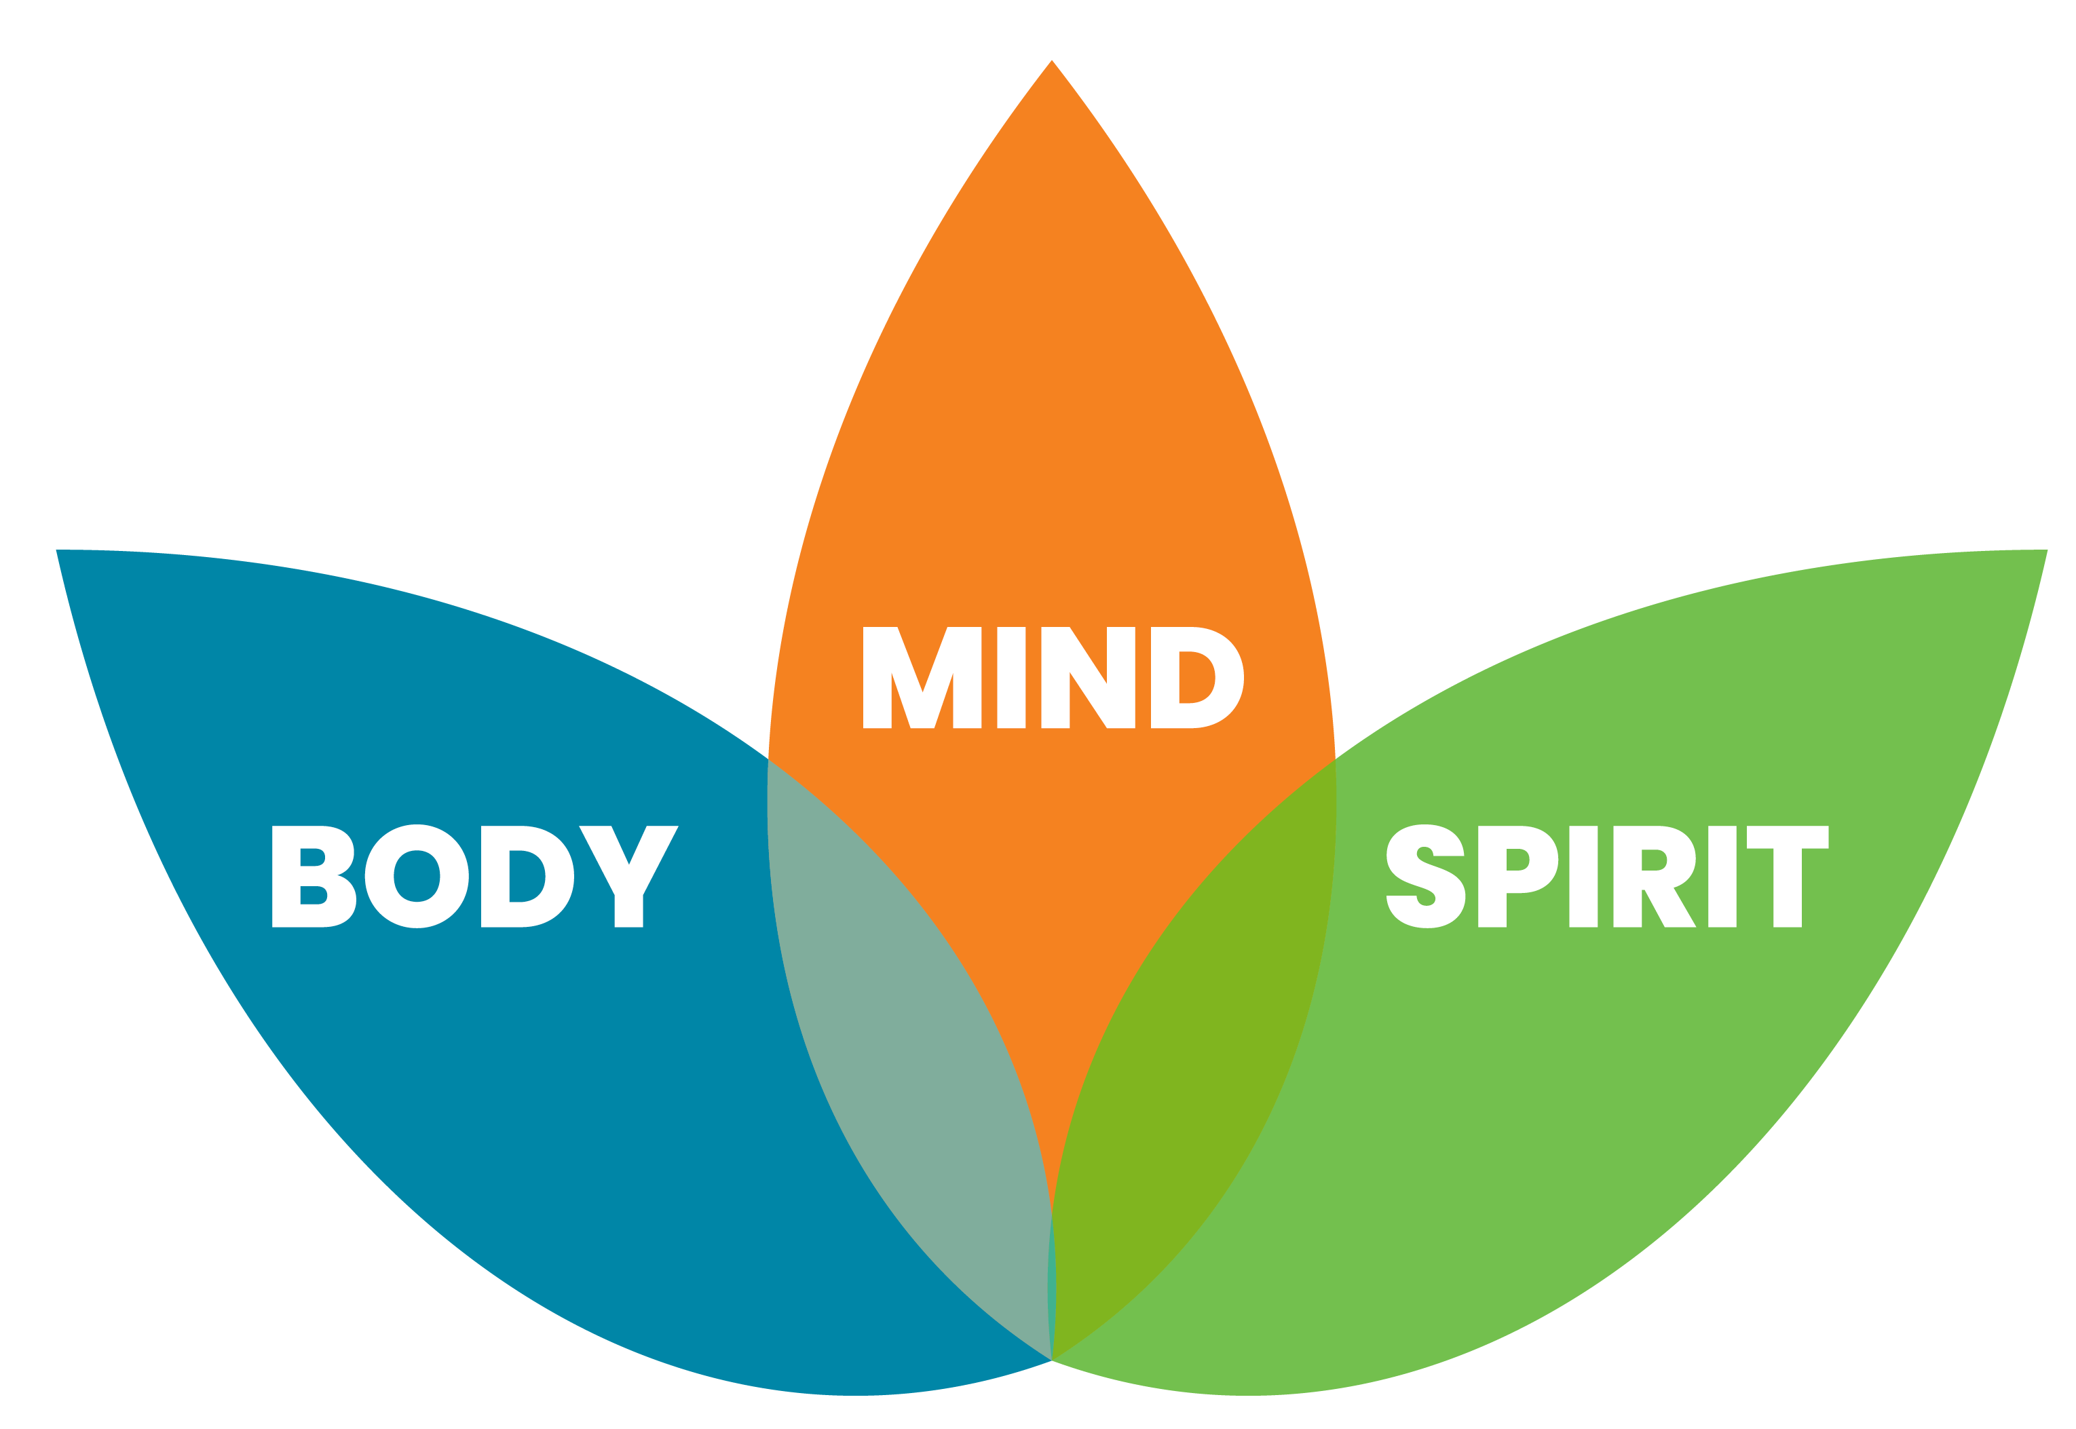
3 Key Areas of Cognitive Health
Strengthening cognitive wellness begins with simple, whole-person habits.

Slide 5

BODY: Boosting Cognitive Energy
Fuel with antioxidant & omega-3 rich foods These nutrients help protect brain cells from inflammation and support memory, focus, and overall cognitive performance.
Stay hydrated to improve thinking speed Even mild dehydration can slow processing, reduce alertness, and increase fatigue—water restores clarity and mental energy.
Move daily to increase blood flow to the brain Gentle activity boosts circulation, delivering oxygen and nutrients that support sharper thinking and better mood.
Maintain consistent sleep routines Regular sleep patterns help regulate attention, memory consolidation, and emotional balance—especially during winter months.

Slide 6
MIND: Boosting Cognitive Energy
Do a daily “brain warmer” like puzzles or word games. Short mental challenges activate memory, attention, and processing speed — just a few minutes helps keep the mind sharp.
Learn something new to strengthen brain pathways. Trying new skills stimulates neuroplasticity, helping the brain form fresh connections that support long-term cognitive health.
Reduce digital overload with short screen breaks. Stepping away from screens gives the brain time to reset, reducing fatigue and improving focus, mood, and clarity.

Slide 7
SPIRIT: Boosting Cognitive Energy
Practice gratitude to support emotional clarity. Gratitude activates brain regions linked to positivity and resilience, helping improve mood, focus, and overall mental balance.
Stay socially connected for cognitive vitality. Regular connection — conversations, shared activities and laughter stimulates memory, attention, and emotional well-being.
De-stress with breathing, meditation, music, or prayer. Calming practices reduce stress hormones, increase clarity, and support clearer thinking throughout the day.

Slide 8
Warm Up Your Brain This Winter
Small, consistent habits help protect memory, improve focus, and lift energy all season long.

Slide 9
Discussion
What small daily habit helps you feel mentally sharper or more energized in winter?
Name one thing you personally will try to support your own Winter Brain.

Slide 10


