Slide 1

National Nutrition Month:
Nourish to Flourish
Why Nutrition Matters as We Age
Presented by
Presenter Name Here
Date Here

Slide 2

Overview
As we grow older, nutrition plays an increasingly important role in maintaining strength, independence, and overall wellness.
During National Nutrition Month, seniors are encouraged to reassess their dietary needs, as proper nutrition can help prevent muscle loss, reduce the risk of chronic disease, and support physical, mental, and emotional health.

Slide 3

Know & Share
Up to 50% of older adults are at risk for malnutrition due to changes in appetite, absorption, or medical conditions.
Poor nutrition in seniors is linked to higher fall risk, slower recovery, and increased hospitalizations.
Eating a variety of nutrient-dense foods can help support longevity and quality of life.

Slide 4
Discussion
How do your food choices impact how you feel each day?
What is one nutrition habit you could improve to support your health?

Slide 5
Shopping & Planning Tips for Seniors & Caregivers
Plan ahead: Make a grocery list to save time and money.
Shop with support: Bring a friend to make trips easier and more enjoyable.
Choose variety: Try new foods to keep meals interesting and nutritious.
Shop the perimeter: Focus on whole foods like produce, meats, and dairy.
Be label-smart: Read labels when buying packaged foods.
Save smart: Use coupons, store discount cards, and affordable store brands.
Set a budget: Choose nutrient-dense foods over empty calories.
Stay hydrated: Water, fruits, and flavored water options all help support hydration.

Slide 6
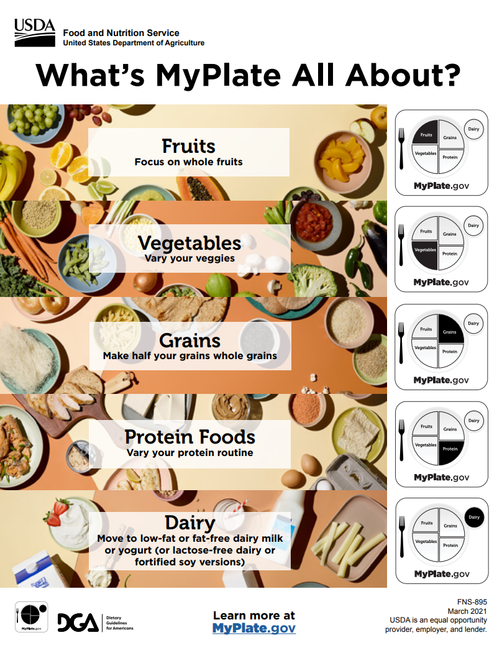
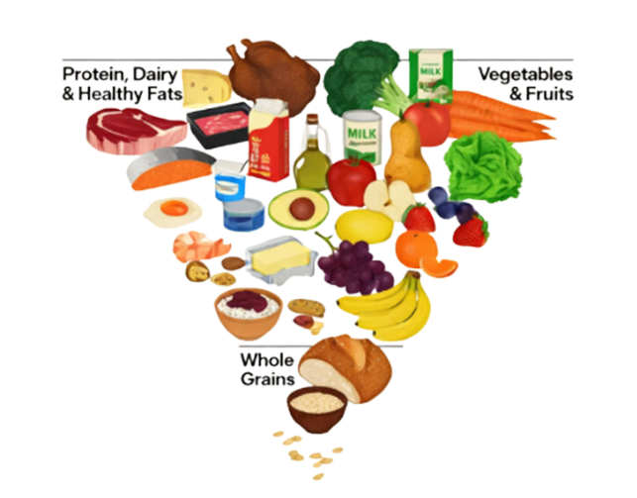
Building Your Perfect Plate

Slide 7
Common Challenges
Reduced appetite or changes in taste
Difficulty absorbing key nutrients like B12 and calcium
Medications that impact digestion or nutrient absorption
Lower protein intake, leading to muscle loss
WHY IT MATTERS
Inadequate nutrition can contribute to weakness, fatigue, and falls
Poor intake may slow healing and recovery
Balanced nutrition supports strength, cognition, and independence

Slide 8
Simple Ways to Focus on Variety
Eat the Rainbow
Choose fruits and vegetables in many colors to get a wide range of vitamins and antioxidants.
🌈
Choose Whole Grains
Swap refined grains for brown rice, whole-wheat pasta, oats, or quinoa for fiber and energy.
🌾
🥛
Add Calcium-Rich Foods
Include dairy, leafy greens, almonds, or tofu to support strong bones.
Mix Up Your Protein
Rotate lean meats, fish, eggs, beans, and plant-based proteins to support muscle and strength.
🥩

Slide 9
Simple Ways to Focus on Variety
Stay Hydrated
Drink water throughout the day to support digestion, circulation, and mental clarity.
💧
Boost Fiber Daily
Whole fruits, vegetables, beans,
and grains help digestion
and gut health.
🍎
Try Something New
Experiment with a new food, recipe, or healthy snack to keep meals enjoyable.
✨
Include Potassium-Rich Foods
Fruits, vegetables, beans, and dairy support heart and muscle function.
🍌

Slide 10
Discussion
What nutrition tip stood out to
you the most today?
What is one small change you
could make to add more
variety to your meals?

Slide 11


