Slide 1
Senior Home Safety

Slide 2
Overview
Home safety is essential for helping older adults remain independent and reduce the risk of injury. Changes in balance, strength, vision, and mobility can make everyday spaces more hazardous over time.
Falls are one of the leading causes of injury among seniors and can often lead to hospitalization, reduced confidence, and loss of mobility.
Simple changes in the home can improve safety, support daily function, and help older adults maintain quality of life.

Slide 3

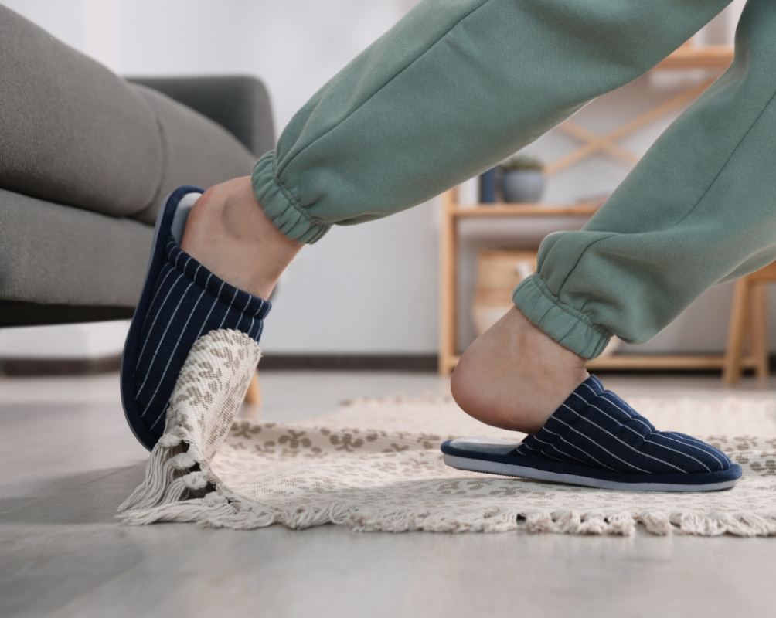
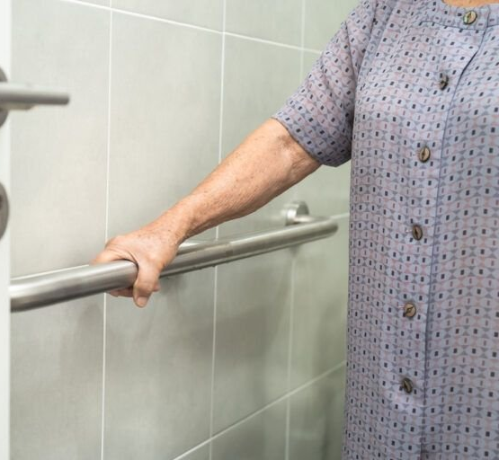
Common Home Hazards
Cluttered Walkways
Loose rugs
No Grab Bars

Slide 4
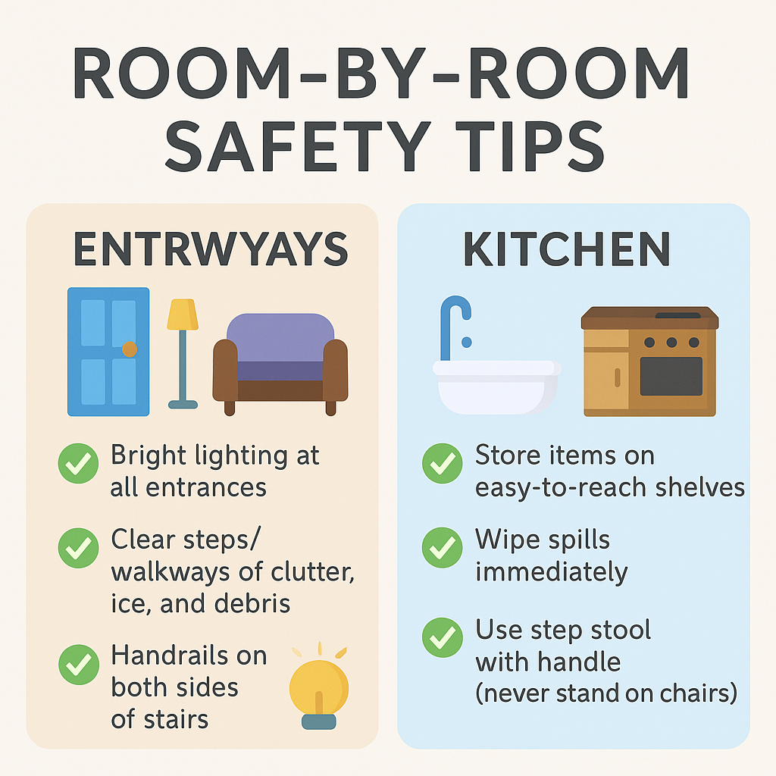
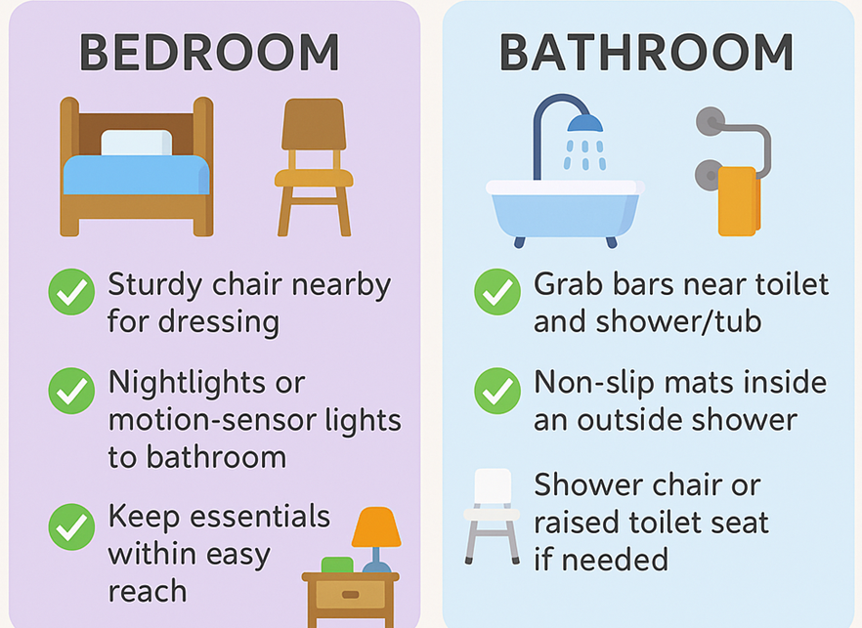
Room-By-Room Safety Tips

Slide 5
Discussion
What area of your home do you
think could be made safer?
Have you ever made a small home
change that helped you feel more comfortable or independent?

Slide 6
Room-By-Room Safety Tips

Slide 7

Fall Prevention Strategies
Staying active helps maintain strength, balance, and coordination, which are key to preventing falls and supporting independence. Even gentle daily movement can improve stability and confidence.
Simple exercises such as chair yoga, sit-to-stand practice, and heel-to-toe walking can strengthen muscles and improve mobility over time.
Supportive tools like canes, walkers, and non-slip footwear can also improve safety and reduce fall risk when needed.

Slide 8
Modifications & Equipment
Simple Home Modifications
Install grab bars near toilets, showers, and bathtubs.
Add non-slip mats in bathrooms and kitchens.
Use shower chairs or bench seats for safer bathing.
Install handrails on both sides of stairs.
Add ramps or threshold ramps for wheelchair or walker access.
Durable Medical Equipment (DME)
Mobility aids: walkers, rollators, canes.
Bathroom safety: raised toilet seats, commodes, transfer benches.
Bed & seating: adjustable beds, lift chairs.
Reaching & gripping tools: Reacher's, dressing sticks, sock aids.

Slide 9
Vision, Hearing & Sensory Considerations
👁 Vision & Lighting
Use bright, even lighting in hallways, stairs, and work areas.
Add task lighting in kitchens, reading areas, and near workstations.
Increase contrast — e.g., dark rugs on light floors, colored tape on stair edges.
Minimize glare by using sheer curtains or adjustable blinds.
👂 Hearing Loss
Hearing loss can make it harder to detect alarms, doorbells, or conversation—impacting safety and independence.
Use visual alerts (flashing lights) for doorbells, smoke alarms, and phones.
Install amplified phones or personal listening devices.
Face the person and speak clearly in well-lit areas for lip reading.
🖐 Sensory Changes
Reduced touch sensation increases risk of burns, frostbite, and injury.
Use temperature-limited faucets and insulated handles on cookware.
Wear well-fitted shoes to improve balance and prevent falls.

Slide 10
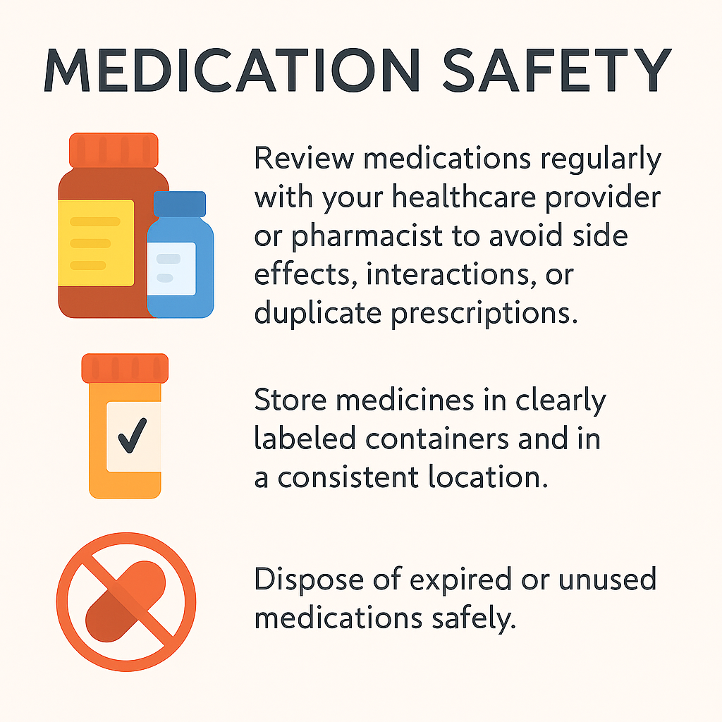
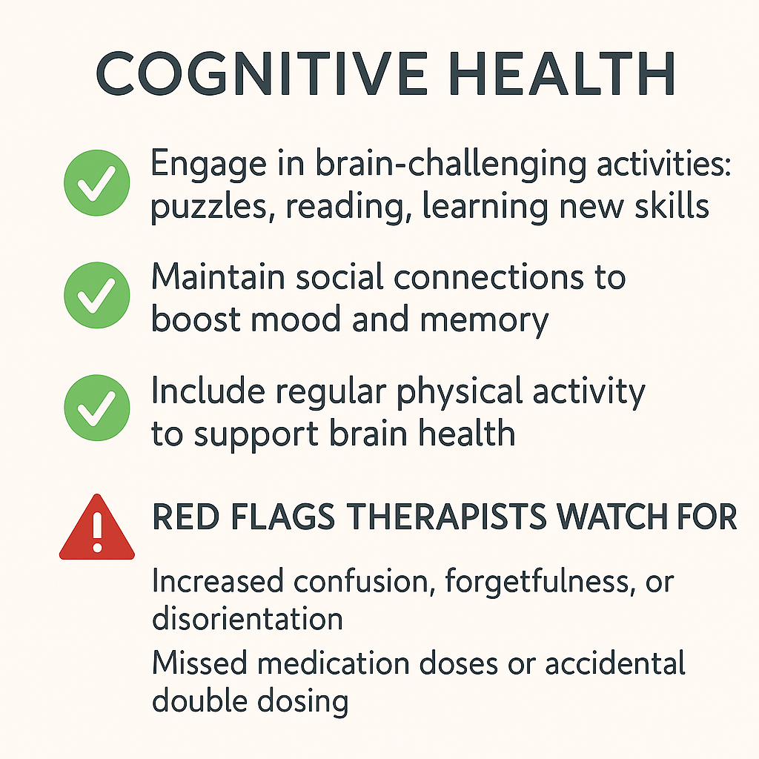
Medication Safety & Cognitive

Slide 11
What a Therapist Can Do For You
Therapists help older adults stay safe, independent, and confident at home by addressing mobility, daily routines, and communication needs.
Occupational therapy focuses on daily tasks and home safety, physical therapy improves strength and balance, and speech therapy supports communication, swallowing, and cognition.
A therapy evaluation can help identify fall risks, recommend helpful equipment, and create strategies that support safer daily living.

Slide 12
Community Resources & Support
Community resources can help older adults stay safe, connected, and supported while living at home. Local programs often provide transportation, wellness services, meal assistance, and opportunities for social connection.
Senior centers, health departments, and aging services can also offer education, screenings, and wellness activities that support independence.
Therapy providers can assist with home safety evaluations, fall prevention strategies, and recommendations for equipment that improves daily safety.

Slide 13
Discussion
Which room in the home do you think needs the most attention for fall prevention?
Which area of the home do you think presents the biggest fall risk?
What support or equipment have you found most helpful for staying safe and independent?

Slide 14



