Slide 1
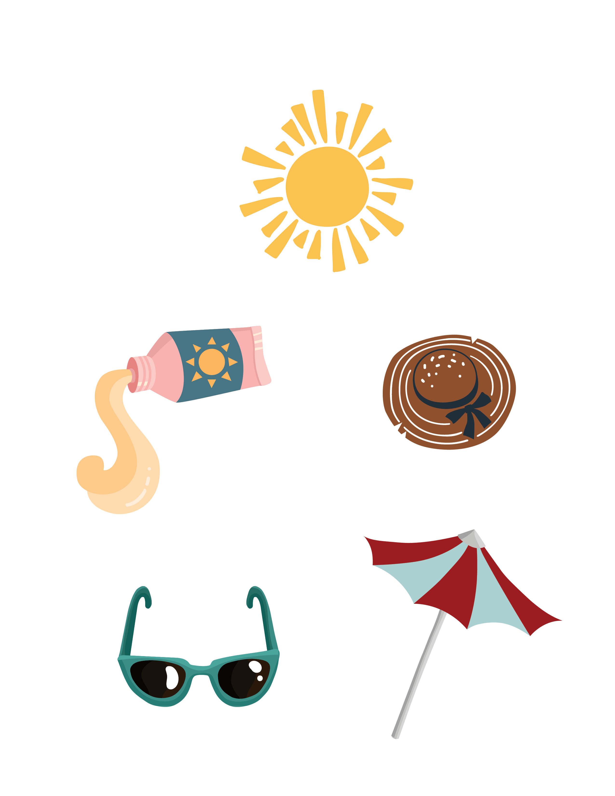
Safe Fun in the Sun

Slide 2
Overview
Summer sunshine abounds in July!
But the extreme heat, it’s a great time to be outdoors soaking up wonderful bone-strengthening Vitamin D.
Just remember these simple, sun-safe tips…

Slide 3
Simple Ways to Stay Safe in the Sun
Wear sunscreen (SPF 30 or higher)
Use hats, sunglasses, and protective clothing
Stay hydrated throughout the day
Take breaks in shaded or indoor areas
Avoid peak sun hours (10 AM – 4 PM)

Slide 4
Discussion
How do you stay safe in the simmer sun?
What steps are you currently taking to safely enjoy the outdoors?

Slide 5
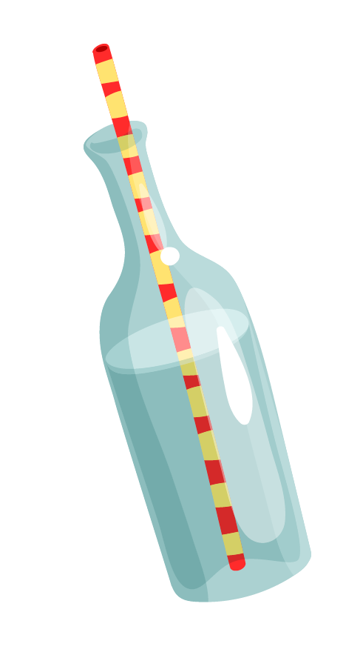
Outdoor Safety Tips
Before You Go Outside
Check the weather and temperature
Apply sunscreen and wear protective gear
Bring water and stay hydrated
Plan for rest breaks
While Outside
• Stay in shaded areas when possible
• Monitor for fatigue or dizziness
• Take breaks as needed

Slide 6
Know & Share
Approximately 10%
of skin aging is caused
by the sun.
People who used sunscreen daily with an SPF of 15 or higher show 24% less skin aging than those who do not.
Sun damage is cumulative
over a lifetime.

Slide 7
Staying Active Safely
Enjoy the Outdoors Safely
Walk during cooler times of day
Choose shaded paths or areas
Stay active with a friend or caregiver
Use assistive devices as recommended

Slide 8
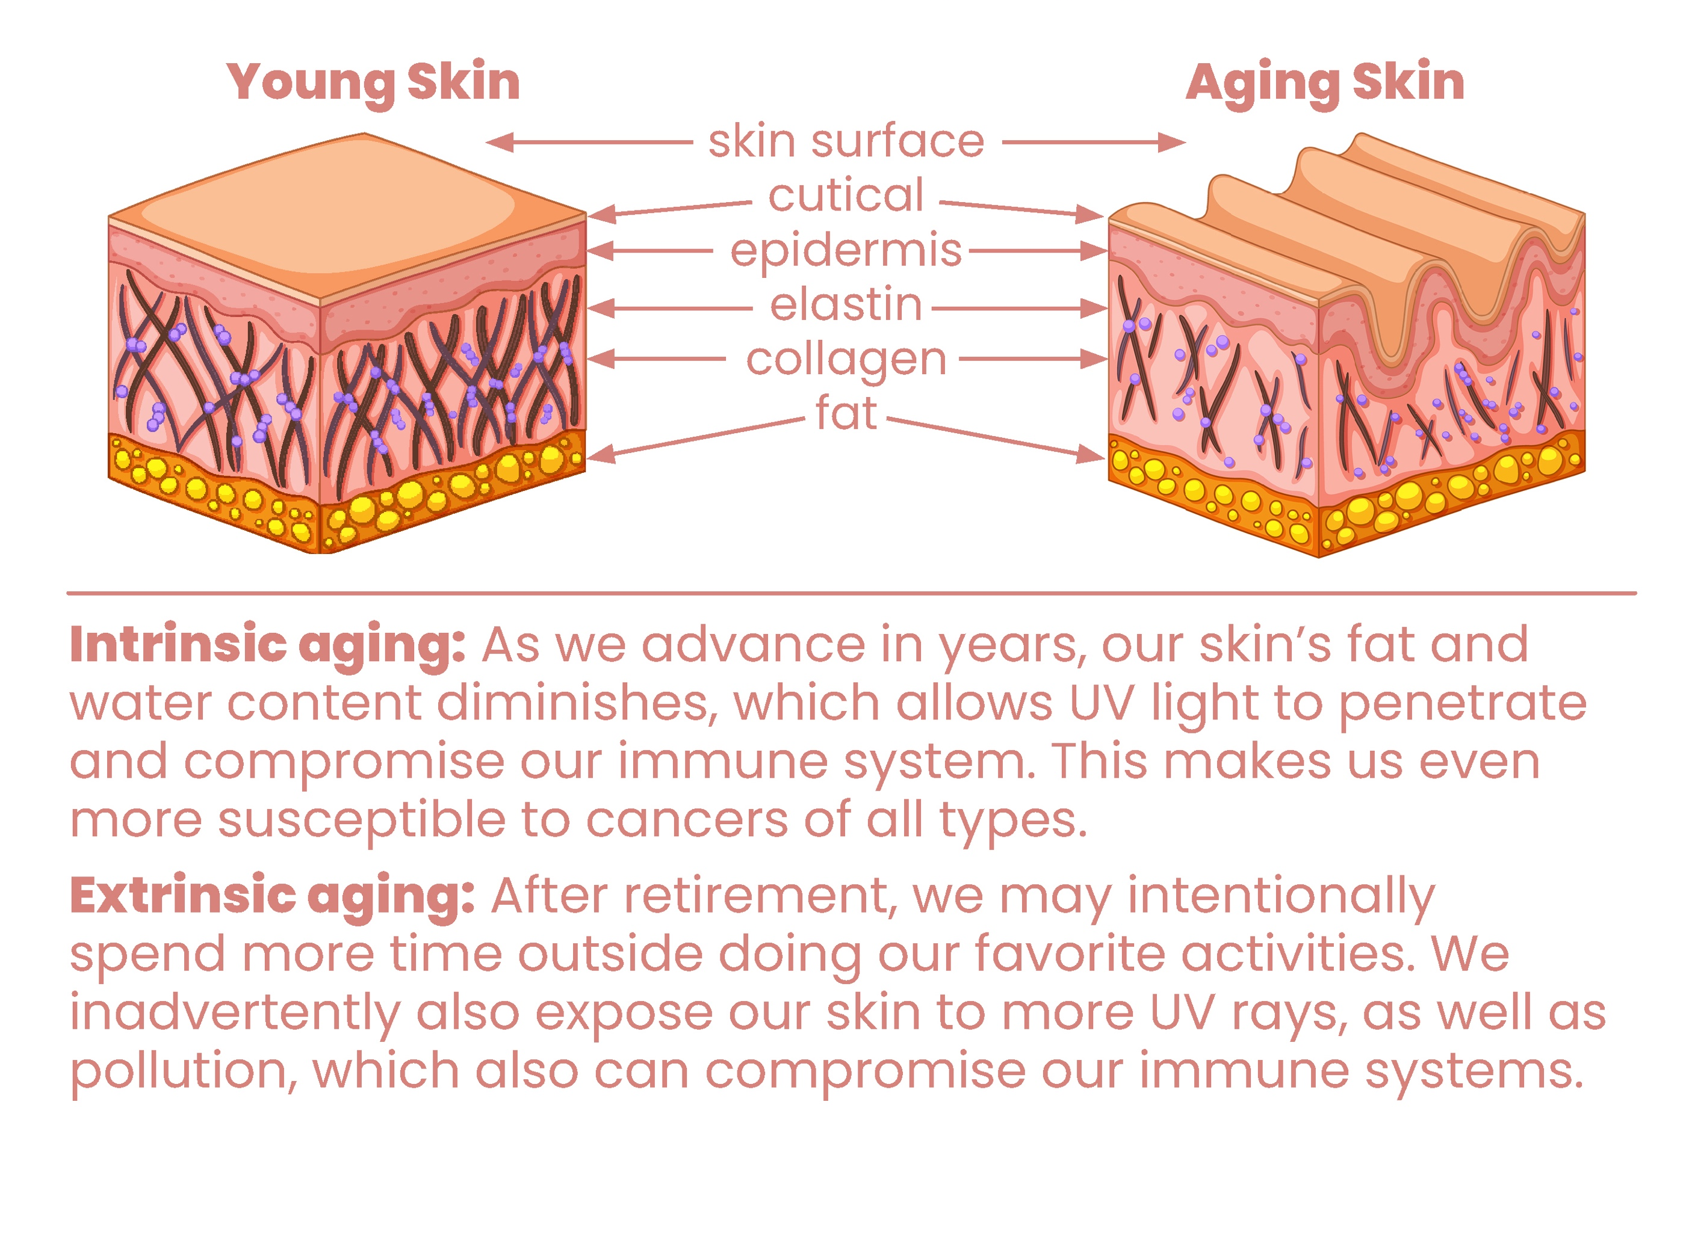

The Skinny on Aging Skin
Reliant Rehabilitation Proprietary Content

Slide 9
Discussion
What are the top things
you learned from today’s
presentation?
Do you have any thoughts to share with our group today about how to safely enjoy the summer sun?

Slide 10
