Slide 1
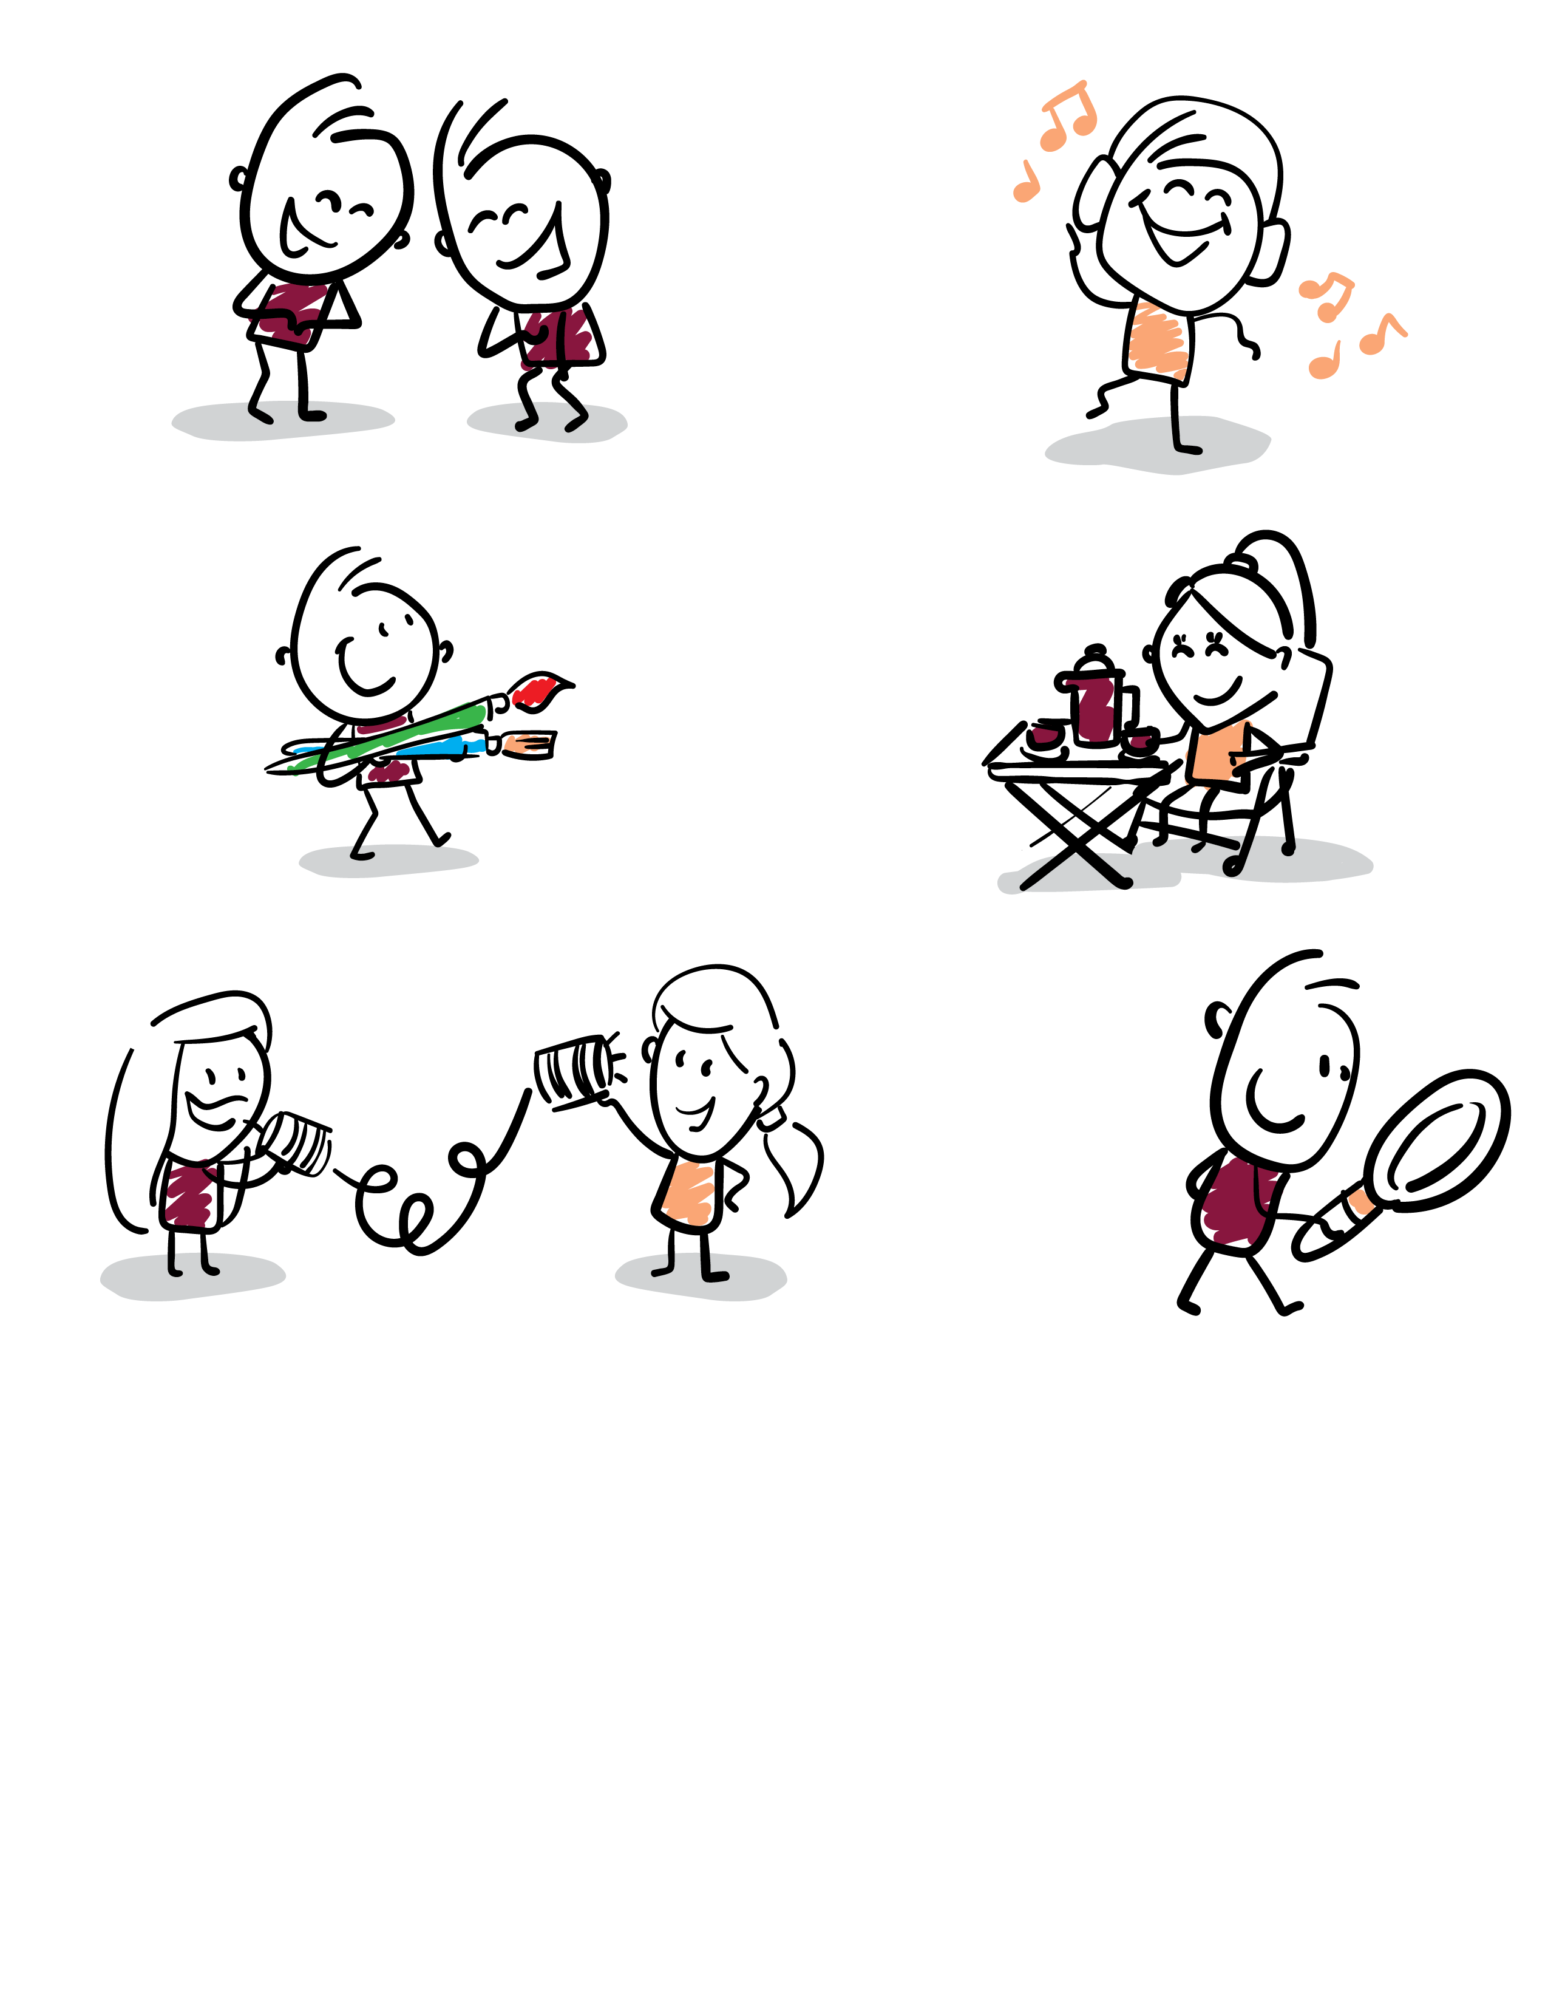
A Year of Wellness | December
Joy Is Good Medicine

Slide 2
Overview
Joy can be found in big celebrations
and in small, everyday moments.
Laughter, connection, movement, purpose and gratitude
can all support emotional well-being and help us stay engaged
with the people and experiences that matter most.
Today we’ll explore simple ways to add a little more joy to each day.

Slide 3
Know & Share
Connection matters.
Spending time with others can help us feel supported, valued and engaged.
Joy can be small.
A favorite song, a warm conversation, a good laugh or time spent outdoors can create meaningful positive moments.
Anticipation
counts, too.
Having something enjoyable to look forward to can be a source of happiness before the event even happens.

Slide 4
Discussion
What is something that almost always
makes you smile?
Who or what brings joy into your day?
Is there something you are looking forward to?

Slide 5
Five Everyday Sources of Joy
CONNECT
Call, visit or spend time with someone you enjoy.
LAUGH
Share a funny story or enjoy something that makes you laugh.
MOVE
Walk, stretch, dance or choose movement that feels good.
CREATE
Make time for music, art, cooking, gardening or a favorite hobby.
GIVE
A kind word or small act of kindness can brighten two people's day.

Slide 6
Purpose, Gratitude & Anticipation
PURPOSE
Hobbies, traditions, helping others and accomplishing small goals can bring meaning and satisfaction to everyday life.
GRATITUDE
Taking time to notice something good can help us appreciate positive moments that might otherwise pass us by.
ANTICIPATION
Planning a visit, activity, meal or other enjoyable experience gives us something positive to look forward to.
Joy doesn’t have to be a big event. Small moments count.

Slide 7
Your Daily Dose of Joy
Rx
ONE DAILY DOSE OF JOY
Connect with someone
Enjoy something you love
Find a reason to smile
Move your body
Look forward to something
Do something kind
Recommended dosage:
A little every day.
Refills:
UNLIMITED

Slide 8
Discussion
What is one small thing you can do this week to add more joy to your day?
What is one joyful moment from your life that you love remembering?
Joy is good medicine. Take a little every day.

